Slide 1




Traffic Management System
A Course Based Project
Presentation By :
A.Rithish -23071A05D7
K.Advaith -23071A0G5
Hanvith Sai -230A05G2
Karthikeya -23071A05G6
G.SriVidya -23071A0F8

Slide 2
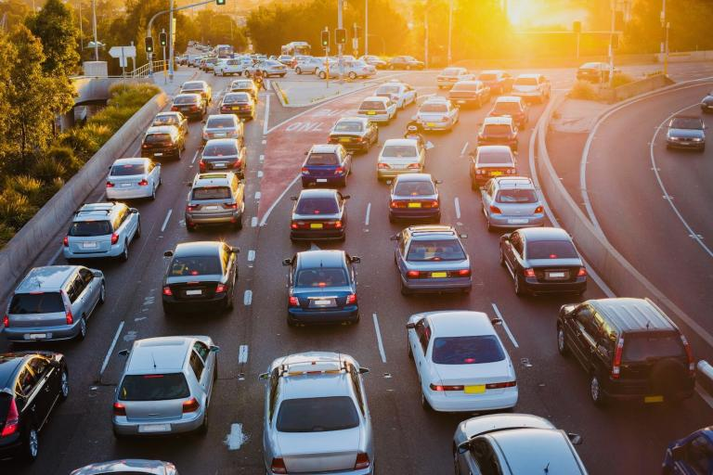

Contents
01 - Abstract
02 - Introduction
03 - Execution
04 - Future Scope
05 - Conclusion

Slide 3

01 - ABSTRACT
Efficient traffic management is essential for urban mobility, reducing congestion, and ensuring the timely passage of emergency vehicles. This paper presents a traffic signal algorithm implemented using data structures like queues and linked lists. The algorithm is designed to manage vehicle flow at a four-way intersection, prioritizing emergency vehicles while maintaining regular traffic operations. The system allows users to create traffic data by enqueuing vehicles, display the current state of traffic lanes, manage the traffic flow by processing vehicles based on their priority, and maintain a log of all processed vehicles for monitoring and auditing purposes. The queue structure facilitates the organized management of vehicles, while the log structure ensures accurate record-keeping of vehicle movements. The program simulates traffic conditions, prioritizes emergency vehicles, and balances the flow of regular traffic, thereby providing a robust framework for real-world traffic signal management systems. Through this algorithm, urban planners and traffic engineers can explore strategies to optimize intersection management and improve overall traffic efficiency.

Slide 4



02-Introduction
Traffic congestion is a persistent issue in urban areas, often leading to delays, increased fuel consumption, and heightened emissions. Effective traffic management at intersections is crucial to alleviating these problems. Managing traffic flow efficiently not only improves transportation systems but also ensures the swift passage of emergency vehicles, thereby enhancing public safety. This program implements a traffic signal algorithm using fundamental data structures such as queues and linked lists to manage the flow of vehicles at a four-way intersection. The algorithm prioritizes emergency vehicles, ensuring their quick passage while maintaining the regular traffic flow. The system allows for the creation, display, and management of vehicle queues in different directions (North, East, South, and West), along with a detailed log of processed vehicles. During heavy traffic only 70% of the vehicles are released to ensure rational traffic flow to all lanes. By simulating traffic management through this algorithm, we can gain insights into optimizing real-world traffic control systems.

Slide 5

OBJECTIVES
1. Efficient Traffic Flow Management:
To organize and manage the movement of vehicles at an intersection in a systematic manner.
2. Prioritization of Emergency Vehicles:
To identify and prioritize emergency vehicles, ensuring they receive immediate passage through the intersection.
3. User Interaction and Input Handling:
To allow users to input traffic data, including the number of vehicles and their respective directions.
4. Simulation of Traffic Conditions:
To simulate real-world traffic conditions and traffic signal operations at a fourway intersection.
5. Vehicle Logging and Monitoring:
To maintain a detailed log of all vehicles processed through the intersection for monitoring and auditing purposes.
6. Balancing Regular Traffic and Emergency Situations:
To balance the flow of regular traffic while ensuring that emergency vehicles are not delayed.

Slide 6

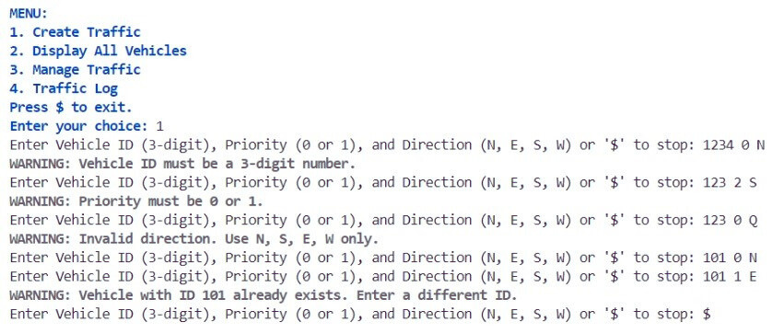

03 - Execution

Slide 7

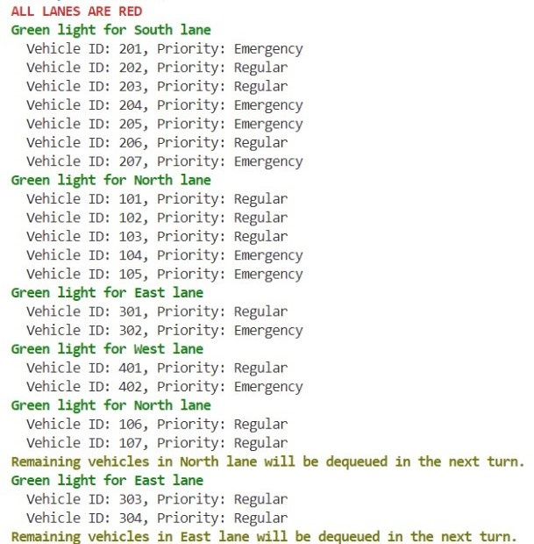

03 - Execution

Slide 8
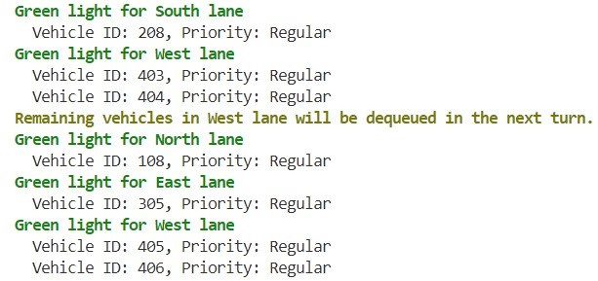
03 - Execution

Slide 9
IoT and AI Integration: IoT devices and AI can dynamically adjust signal timings using real-time traffic data, predicting patterns, optimizing intersections, and enhancing safety autonomously.
V2X Communication: Vehicle-to-Everything technology enables communication between vehicles, infrastructure, and signals for coordinated traffic management and emergency vehicle prioritization.
Predictive Analytics: Forecasting traffic demand and preemptively adjusting signal timings helps mitigate congestion, improving traffic flow during peak hours and special events.
Environmental Considerations: Future iterations can reduce emissions and energy consumption by minimizing idle times at intersections, contributing to lower carbon footprints and better air quality.
Multi-modal Integration: The algorithm can accommodate diverse transportation modes, supporting holistic traffic management strategies and promoting sustainable urban mobility.
Smart City Integration: Interfacing with smart city systems like grids and public safety networks, the algorithm supports comprehensive city management, enhancing livability and resilience.
Global Urbanization Trends: Scalability and adaptability across various urban landscapes and demographics ensure the algorithm can meet the needs of megacities and developing regions, providing efficient and inclusive transportation solutions.
FUTURE SCOPE

Slide 10

In conclusion, the traffic signal algorithm developed in this project represents a significant advancement in urban traffic management, addressing critical issues such as congestion, delays, and emergency vehicle prioritization. By efficiently managing the flow of vehicles at a four-way intersection, the algorithm enhances overall traffic efficiency while ensuring the timely passage of emergency responders.
CONCLUSION

Slide 11


